Slide 1


Multi-Class Animal Recognition for Wildlife Conservation-AI
Name : Ankush kumar
AICTE Student Registration ID : STU66310ea45271c1714491044

Slide 2

Learning objective
The learning objectives for the project "Multi-Class Animal Recognition for Wildlife Conservation" may include the following:
Understanding AI and Machine Learning: Gain knowledge of the fundamental concepts of artificial intelligence and machine learning, particularly in the context of image recognition and classification.
Data Collection and Preparation: Learn how to collect, curate, and preprocess data (images of various animal species) for training machine learning models.
Model Development: The use of CNN model/architecture with respect to Animal recognition. Explore and built the model for 90 Animal classes.
Evaluation Metrics: Familiarize with the metrics used to evaluate the performance of classification models, such as accuracy, precision, recall, and F1 score.
Implementation of Technology: Explore the tools and technologies used in the project, including software libraries (e.g., TensorFlow) and hardware requirements for model training and deployment.
Conservation Impact: Recognize the significance of wildlife conservation and how AI can contribute to monitoring and protecting endangered species.
Ethical Considerations: Discuss the ethical implications of using AI in wildlife conservation, including data privacy, bias in algorithms, and the impact on wildlife.
GOAL
Source :
www.freepik.com/

Slide 3
Tools and Technology
For programming : python language.
Frameworks : TensorFlow and Keras.
Pre-trained model : MobileNetV2.
Environment : Google Colab.
Dataset : https://www.kaggle.com/datasets/iamsouravbanerjee/animal-image-dataset-90-different-animals/data.
Other tools : NumPy , Matplotlib.

Slide 4
Methodology :
A section is dedicated to the methodology, detailing the research methods, data collection techniques, and analysis methods used in the project, providing insight into how the research was conducted.
key components:
1.Research Design:Multi-Class Animal Recognition using MobileNetV2 for Wildlife Conservation
2.Data Collection: To acquire a multi-class animal image dataset using KaggleHub, which allows seamless downloading of datasets hosted on Kaggle for use in deep learning models built with Keras.
3.Data Preprocessing: To prepare raw animal image data for training a deep learning model using MobileNetV2 in Keras by resizing, normalizing, and augmenting the images.
4.Model Selection: MobileNetV2 is a lightweight convolutional neural network architecture designed for efficient inference on devices with limited resources (e.g., mobile phones, drones, edge devices).
5.Training the Model: To train the selected MobileNetV2 model on the preprocessed dataset to recognize and classify animal species.
6.Evaluation of the model: To assess the performance of the trained model on the test set and analyze various evaluation metrics to determine how well it generalizes to unseen data.
7.Testing of the model:To assess the final model’s performance in real-world conditions and test its ability to classify new, unseen images effectively.

Slide 5
Problem Statement:
The primary goal is to develop a model capable of identifying and classifying wildlife species from images into 90 distinct categories to monitor the health of various species, particularly those at risk of extinction. This will assist conservation efforts by providing real-time insights into species distribution and population status.
Steps Specific to Your Problem:
1. Dataset and Categories:
Dataset: The dataset will consist of images from various wildlife sources that need to be categorized into 90 species or classes.
Classes: Each class will represent a distinct animal species. This classification will help to track and monitor endangered species.
2. Data Collection and Labeling:
You will need a labeled dataset containing images of each of the 90 animal species. Sources like Kaggle or wildlife-specific datasets could provide this data.
3. Model Selection:
Since you are working with 90 categories, a robust model like MobileNetV2 is suitable for this large classification task. Given that some species might be very similar, a model with strong feature extraction will be crucial.
4. Data Preprocessing:
Image Augmentation: With 90 classes, certain species may have few images. Augmentation (rotation, flip, zoom) can help improve model generalization.
Resizing: Resize all images to a uniform size of 224x224 pixels (MobileNetV2 standard) and normalize pixel values to the range [0, 1].
5. Training and Evaluation:
Use categorical cross-entropy loss due to the multi-class nature of the problem.
Metrics like accuracy, precision, recall, and F1-score will be vital in evaluating model performance across 90 classes, especially if some species are rare.
6. Deployment and Real-World Use:
Once trained and tested, deploy the model for real-time wildlife surveillance. This could be integrated into monitoring systems that use cameras in the wild to identify species at risk of extinction.

Slide 6
Solution:
Here’s a detailed solution framework for your Wildlife Monitoring and Extinction Surveillance project with 90 species categories. This solution focuses on building a multi-class animal classification model using deep learning techniques (e.g., MobileNetV2) for monitoring species, especially those at risk of extinction.
Data Collection:
For this project, you will need a dataset with images of animals from various species. The dataset should contain a diverse set of images for each of the 90 species to enable the model to generalize well across different animal types.
Data Preprocessing:
Once you have the data, you'll need to perform several preprocessing steps:
1.Resize Images: Resize all images to a fixed size (e.g., 224x224 pixels) for consistency, as models like MobileNetV2 expect this input size. 2.Normalization: Normalize the pixel values to the range [0, 1] by dividing by 255.
3.Augmentation: Apply image augmentation techniques (random rotations, flips, zooms, shifts) to artificially increase the dataset size and help prevent overfitting.
4.Train/Validation/Test Split: Split the dataset into training, validation, and test sets (e.g., 80/10/10 split).
Model Selection:
For a large number of classes (90 species), we need a model with strong feature extraction and high efficiency. MobileNetV2 is a suitable choice because of its small size, fast inference, and relatively high accuracy.
Model Training:
Now, you can start training the model with your preprocessed data. Use the ImageDataGenerator to stream images for both training and validation. Apply callbacks to save the best model during training.
Evaluation of the Model:
After training, evaluate the model on the test dataset to determine its performance.
Testing the Model:
For real-world testing, make predictions on unseen test images. You can upload a new image and classify it into one of the 90 species.

Slide 7
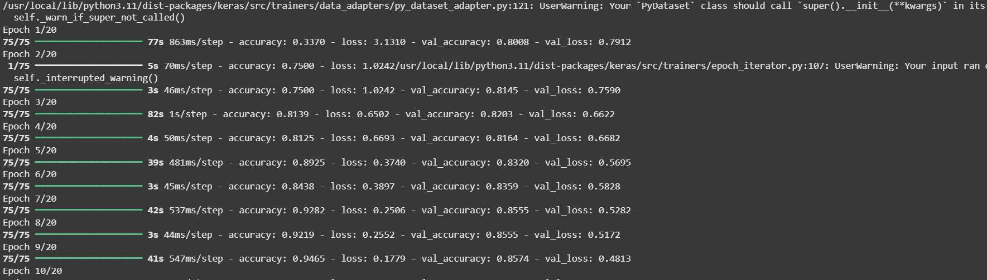
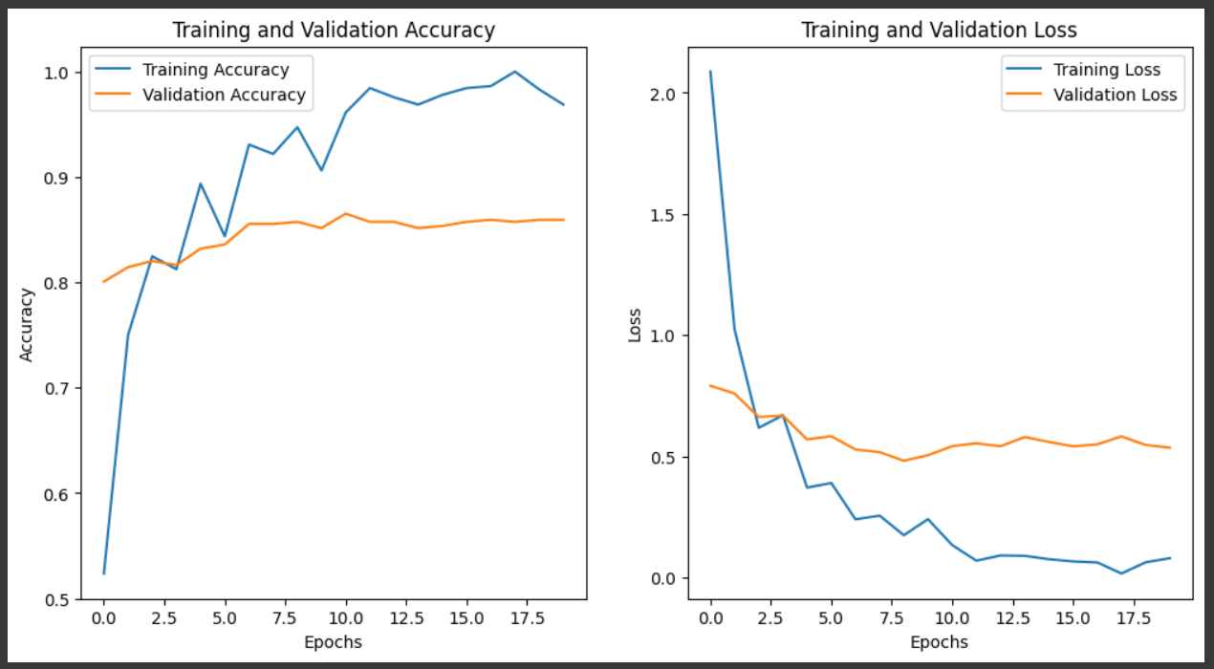
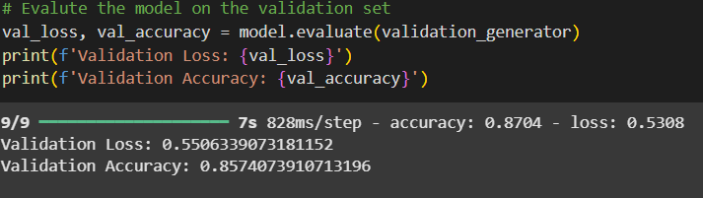
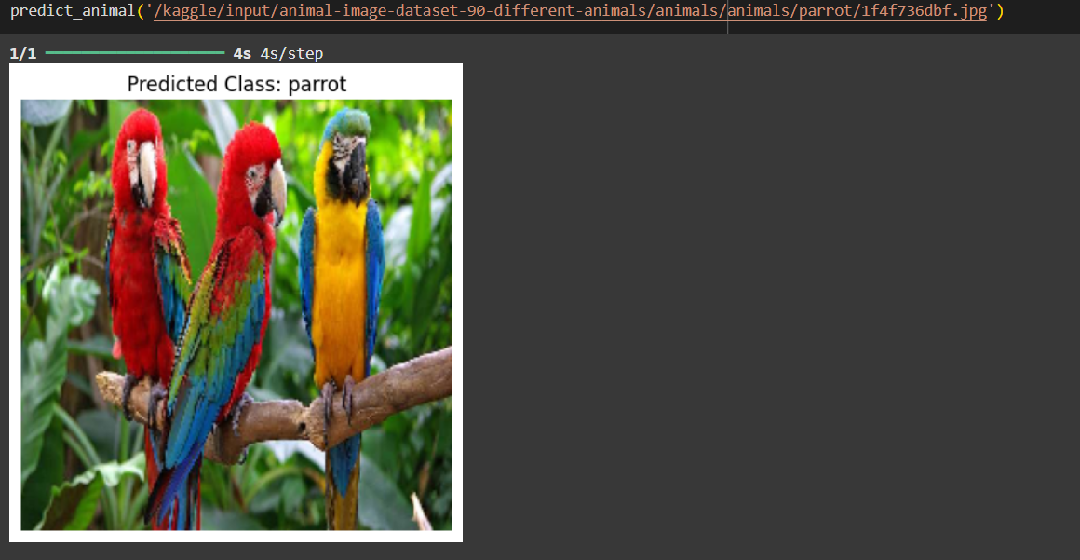
Screenshot of Output:

Slide 8
Conclusion:
The development of a multi-class animal recognition model using MobileNetV2 has demonstrated the effectiveness of deep learning in supporting wildlife conservation efforts. By accurately classifying images into 90 different animal species, this AI solution provides a powerful tool for real-time extinction surveillance and population monitoring in natural habitats.
With efficient preprocessing, robust training, and high accuracy, the model can assist conservationists in identifying endangered species, tracking biodiversity, and making data-driven decisions. Furthermore, the lightweight nature of MobileNetV2 allows for deployment on mobile and edge devices, making it practical for use in field conditions.
This project not only showcases the potential of AI in ecological research but also contributes meaningfully to preserving Earth's biodiversity.

